Slide 1
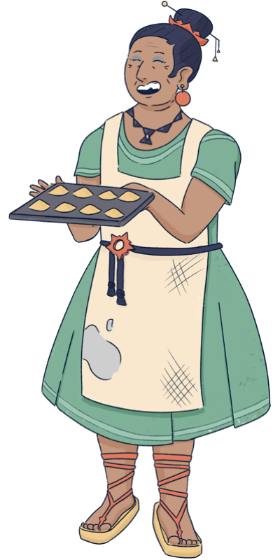
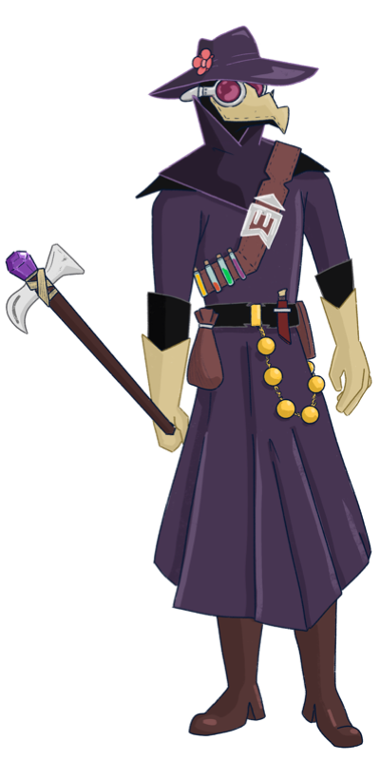
You must be the new doctor! I have been waiting for you…
Sorry ma’am, you must mistake me for my old grandpa.
I am wearing the same outfit, and I have his old manual,
but I have no experience, no way I can help you.
Also, I plan to be in town only for one week,
I do not have time for this…
It is impossible to recognize you, with that mask…
I am sure you are as talented as the old doctor!
Please help me, we have plenty of time today.
And as a reward, I will make you try my new recipe.
I baked delicious broccoli cookies!

Slide 2
ADD SLIDES FOR TUTORIAL
EXPLAIN THE BUTTONS

Slide 3
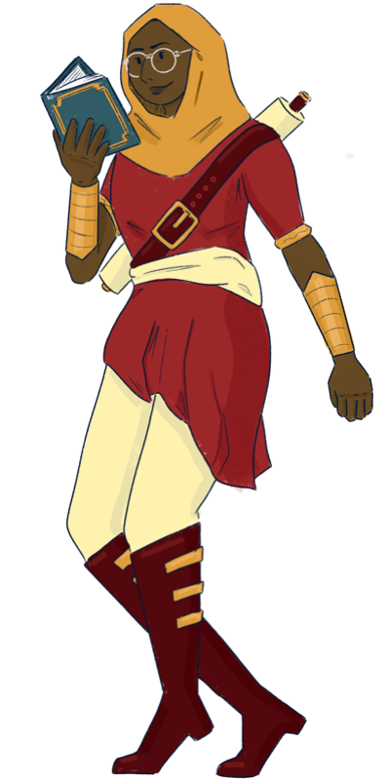
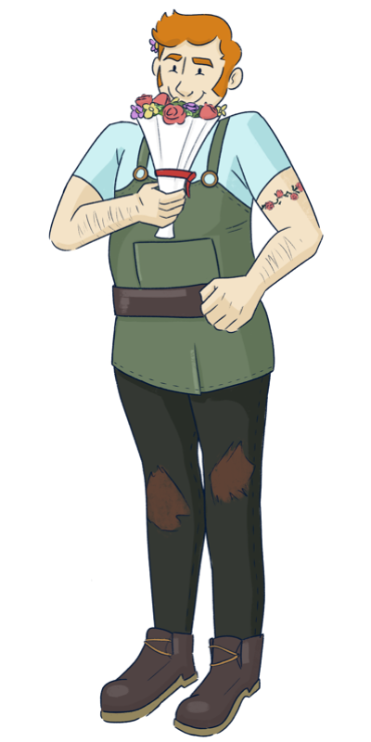
So… you are the “young doctor.”
The village is small, and Bella told everyone about you
(and also about the broccoli cookie, blah!)
I guess you can help me, I found not help in this book…
I guess I am doomed! What a terrible vacation.
I have only a few days left in the village,
I wonder how desperate they are to ask help to me…
Sorry to bother you, but I am also in need for help.
Please, we really need you. Everyone in the village
is happy to help each other, we will not forget this!

Slide 4
EXPLAIN THAT YOU CAN GET EXPERIENCE AND USE IT TO IMPROVE SKILLS AND BE MORE ACCURATE
FROM NOW ON YOU HAVE FEWER TESTS AVAILABLE EACH DAY
CHOOSE CAREFULLY THE TEST TO USE

Slide 5
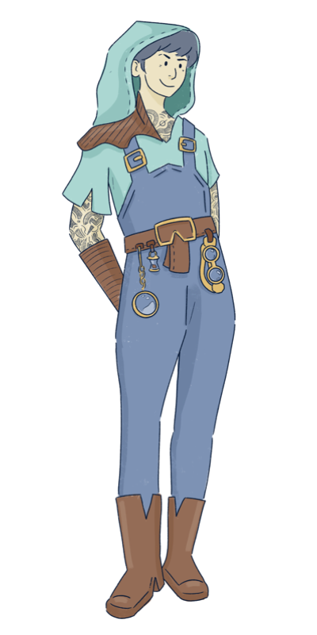
So… you are the “young doctor.”
The village is small, and Bella told everyone about you
(and also about the broccoli cookie, blah!)
I guess you can help me, I found not help in this book…
I guess I am doomed! What a terrible vacation.
I have only a few days left in the village,
I wonder how desperate they are to ask help to me…
Sorry to bother you, but I am also in need for help.
Please, we really need you. Everyone in the village
is happy to help each other, we will not forget this!

Slide 6
EXPLAIN THAT RECURRENT PATIENTS ARE EASIER TO CURE (SOME SYMPTOMS ARE ALREADY REVEALED) BUT GIVE LESS EXPERIENCE

Slide 7
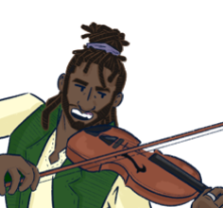
So… you are the “young doctor.”
The village is small, and Bella told everyone about you
(and also about the broccoli cookie, blah!)
I guess you can help me, I found not help in this book…
I guess I am doomed! What a terrible vacation.
I have only a few days left in the village,
I wonder how desperate they are to ask help to me…
Sorry to bother you, but I am also in need for help.
Please, we really need you. Everyone in the village
is happy to help each other, we will not forget this!

Slide 8
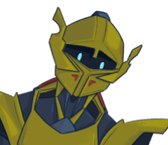
So… you are the “young doctor.”
The village is small, and Bella told everyone about you
(and also about the broccoli cookie, blah!)
I guess you can help me, I found not help in this book…
I guess I am doomed! What a terrible vacation.
I have only a few days left in the village,
I wonder how desperate they are to ask help to me…
Sorry to bother you, but I am also in need for help.
Please, we really need you. Everyone in the village
is happy to help each other, we will not forget this!

Slide 9
So… you are the “young doctor.”
The village is small, and Bella told everyone about you
(and also about the broccoli cookie, blah!)
I guess you can help me, I found not help in this book…
I guess I am doomed! What a terrible vacation.
I have only a few days left in the village,
I wonder how desperate they are to ask help to me…
Sorry to bother you, but I am also in need for help.
Please, we really need you. Everyone in the village
is happy to help each other, we will not forget this!

Slide 10
THANK YOU SO MUCH!!!
This is the your last day in town,
Time for the last check-up visits!
OK OK, but I do not have much time!
(They are so demanding, but I will miss them)
So don’t waste time!
I have a delicious cake in the oven,
I do not want to burn it (again)

Slide 11
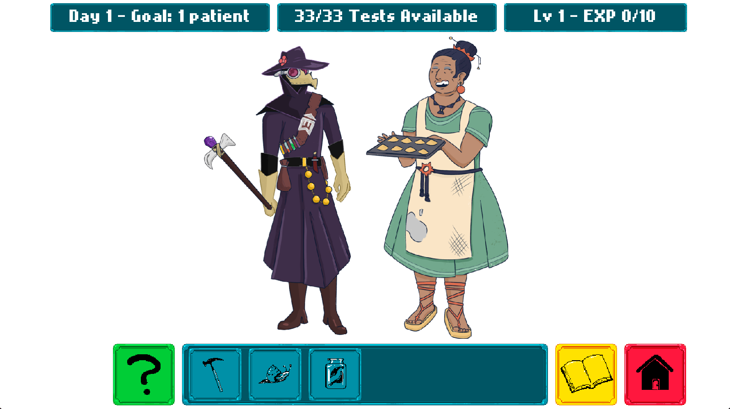

Slide 14

1. Visit the Patients
Each day some patients seek your help
Sometimes their symptoms are visible, other times you cannot be sure
You can run tests (blue icons) to learn more about their symptoms
Click on a patient to read their report, then click on the test icons to update the report with the new results
Your tests are not perfect, you can improve them during the game
You have a limited number of tests available every day
Click on the red icon (home) to return to the main screen

Slide 15
2. Consult the Manual
Click on the manual (yellow icon) to see the list of known diseases
You unlock more diseases and symptoms during the game
Each disease has a typical pattern of symptoms.
Some of them always appear in the sick patients, others never appear, and others might appear with different likelihood
Consult the manual to decide which tests are most useful for your diagnosis
The manual also contains the correct treatment for each disease

Slide 16
3. Treat the Patients
When you run out of tests, it’s time to treat you patients
Click on a patient to open the report page
You cannot run tests anymore, but you can assign a treatment to each patient
Click on the right column to assign a medicinal herb
You find the correct treatment for each disease in the manual
After you choose a treatment for each patient, the day is over
You will see the report with information about which patients are healed

Slide 17
4. Experience and Days Progression
In order to proceed, you need to save at least the target number of patients
If you fail, you will restart the day
If you succeed, you also collect experience based on which patient you saved. Each patient has a different experience value
Experience points make you advance to the next level and unlock new skills
You can use the skill points to improve the accuracy of your test
A test with higher accuracy makes fewer mistakes

Slide 18



Slide 22
VISIT THE PATIENTS
Each day some patients seek your help
Sometimes their symptoms are visible, other times you cannot be sure
You can run tests (blue icons) to learn more about their symptoms
Click on a patient to read their report, then click on the test icons to update the report with the new results
Your tests are not perfect, you can improve them during the game
You have a limited number of tests available every day
Click on the red icon (home) to return to the main screen

Slide 23
CONSULT THE MANUAL
Click on the manual (yellow icon) to see the list of known diseases
You unlock more diseases and symptoms during the game
Each disease has a typical pattern of symptoms. Some of them always appear in the sick patients, others never appear, and others might appear with different likelihood
Make sure you consult the manual to decide which tests are most useful for your diagnosis
The manual also contains the suggested treatment for each disease

Slide 24
TREAT THE PATIENTS
When you run out of tests, it’s time to treat you patients
Click on a patient to open the report page
You cannot run tests anymore, but you can assign a treatment to each patient
Click on the right column to assign a medicinal herb
You find the correct treatment for each disease in the manual
After you choose a treatment for each patient, the day is over
You will see the report with information about which patients are healed

Slide 25
EXPERIENCE AND DAYS PROGRESSION
In order to proceed to the next day, you need to save at least the target number of patients
If you fail, you will restart the day
If you succeed, you also collect experience based on which patient you saved. Each patient has a different experience value
Experience points make you advance to the next level and unlock new skills
You can use the skill points to improve the accuracy of your test
A test with higher accuracy makes fewer mistakes

